Slide 1
Cloud Applications

Slide 2
Software Development Kits
Azure SDK for .NET
The Azure SDK for .NET is a set of Visual Studio tools, command-line tools, runtime binaries, and client libraries that help you develop, test, and deploy apps that run in Azure.
The Azure SDK for .NET also comprises client libraries for consuming Azure services.

Slide 3
What Azure SDK Contains?
The Azure SDK for .NET installs the following products:
Visual Studio Express for Web
Microsoft ASP.NET and Web Tools for Visual Studio
Microsoft Azure Tools for Microsoft Visual Studio
Microsoft Azure Authoring Tools
Microsoft Azure Emulator
Microsoft Azure Storage Emulator
Microsoft Azure Storage Tools
Microsoft Azure Libraries for .NET
HDInsight Tools for Visual Studio and Microsoft Hive ODBC Driver
Microsoft Azure Mobile App SDK V1.0
Microsoft Azure PowerShell

Slide 4
Azure SDK
Visual Studio Express for Web
If you don't have Visual Studio on your computer, the SDK will install Visual Studio Express for Web.
Microsoft ASP.NET and Web Tools for Visual Studio
This enables you to work with Azure Websites
Microsoft Azure Tools for Microsoft Visual Studio
This enables you to work with Azure resources, primarily Cloud Services and Virtual Machines

Slide 5
Azure SDK
Microsoft Azure Authoring Tools
This includes the following:
The CSPack command-line tool for creating deployment packages.
the CSEncrypt command-line tool for encrypting passwords that are used to access cloud service role instances through a remote desktop connection.
Runtime binaries that cloud service projects require for communicating with their runtime environment and for diagnostics. These binaries are not available in NuGet packages.

Slide 6
Azure SDK
Microsoft Azure Emulator
The Azure Emulator simulates the cloud service environment so that you can test cloud service projects locally on your computer before you deploy them to Azure.
Microsoft Azure Storage Emulator
The Azure Storage Emulator uses a SQL Server instance and the local file system to simulate Azure Storage (queues, tables, blobs), so that you can test locally.

Slide 7
Azure SDK
Microsoft Azure Storage Tools
This installs AzCopy, a command line tool you can use to transfer data into and out of an Azure Storage account.
Microsoft Azure Libraries for .NET
This includes the following:
NuGet packages for Azure Storage, Service Bus, and Caching that are stored on your computer so that Visual Studio can create new cloud service projects while offline.
A Visual Studio plug-in that enables In-Role Cache projects to run locally in Visual Studio.

Slide 8
Azure SDK
HDInsight Tools for Visual Studio, and Microsoft Hive ODBC Driver
HDInsight tools in Server Explorer enable you to navigate Hive databases and linked storage accounts for HDInsight clusters, create tables, and create and submit Hive queries.
Microsoft Azure Mobile App SDK
Tools for working with Azure App Service Mobile Apps.
Microsoft Azure PowerShell
Azure PowerShell enables you to automate Azure environment creation and deployment.

Slide 9
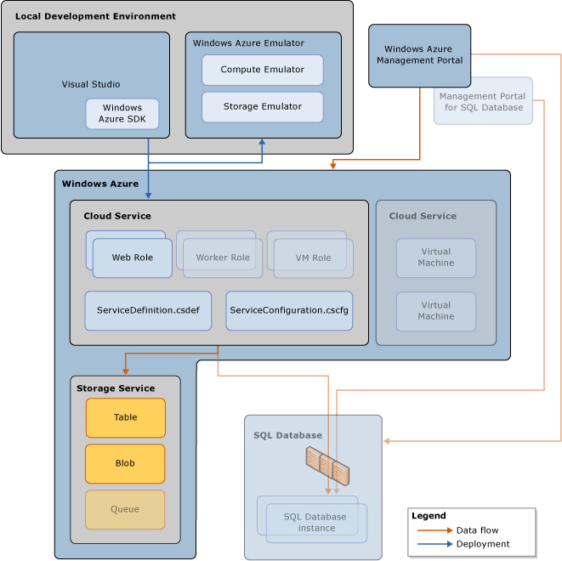

Slide 10
Cloud Project with a Web Role
Start Microsoft Visual Studio as an administrator.
On the menu bar, choose File, New, Project.
In the Project Types pane, choose Cloud from the Visual C# or Visual Basic project template nodes.
In the Templates pane, choose Azure Cloud Service.
Specify which version of the .NET Framework you want to use to develop your project.
Enter a name and location for your project and a name for the solution. Choose the OK button.

Slide 11
Cloud Project with a Web Role
In the New Azure Project dialog box, choose the roles that you want to add, and choose the right arrow button to add them to your solution. You can add as many roles as you need.
To rename a role that you've added to your project, pause on the role in the New Azure Projectdialog box, and choose the Rename icon to the right of the role. You can also rename a role within your solution after it has been added.
Choose the OK button to create your solution in Visual Studio.

Slide 12
Cloud Project with a Web Role
In the New Azure Project dialog box, choose the roles that you want to add, and choose the right arrow button to add them to your solution. You can add as many roles as you need.
To rename a role that you've added to your project, pause on the role in the New Azure Projectdialog box, and choose the Rename icon to the right of the role. You can also rename a role within your solution after it has been added.
Choose the OK button to create your solution in Visual Studio.

Slide 13
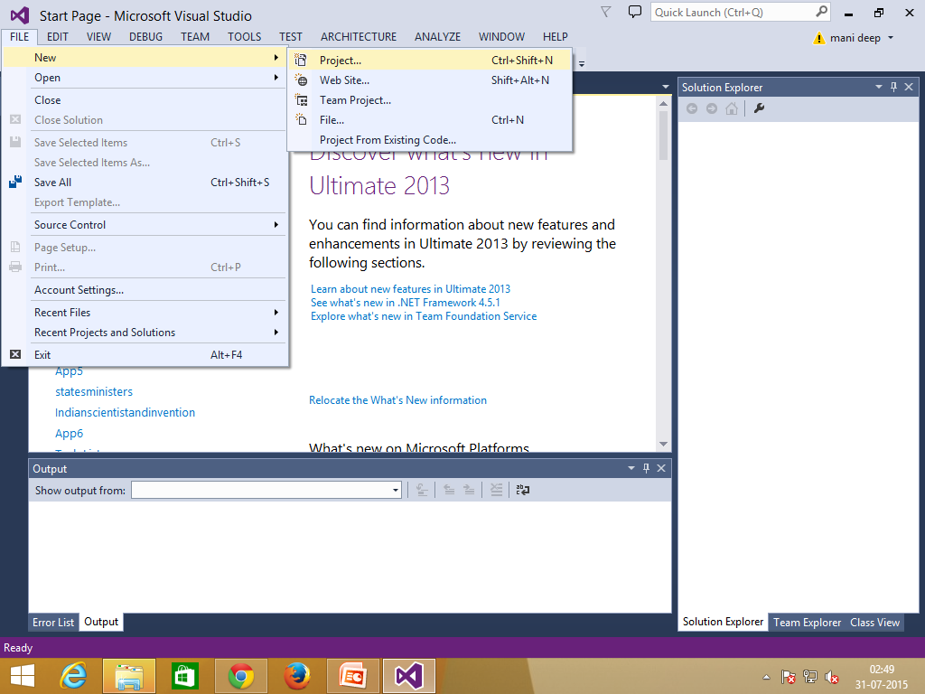
Cloud Project with a Web Role

Slide 14
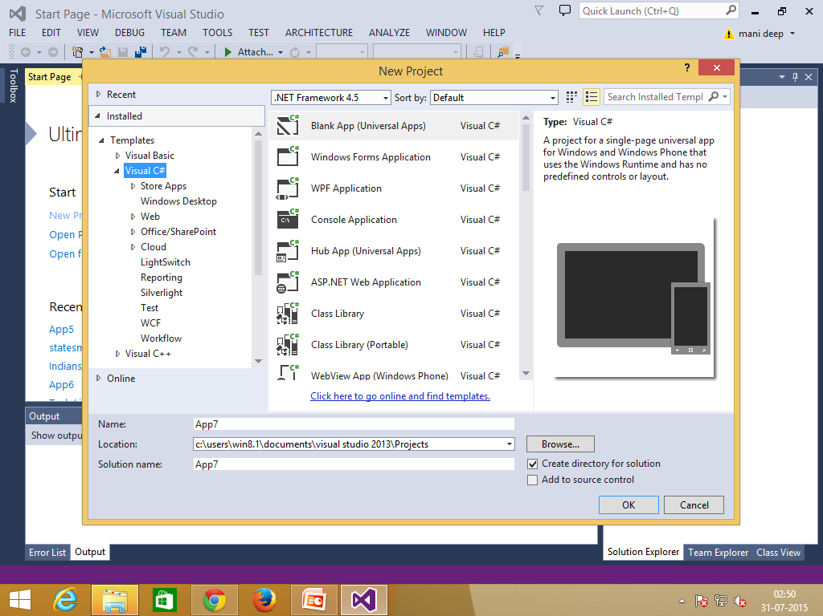
Cloud Project with a Web Role

Slide 15
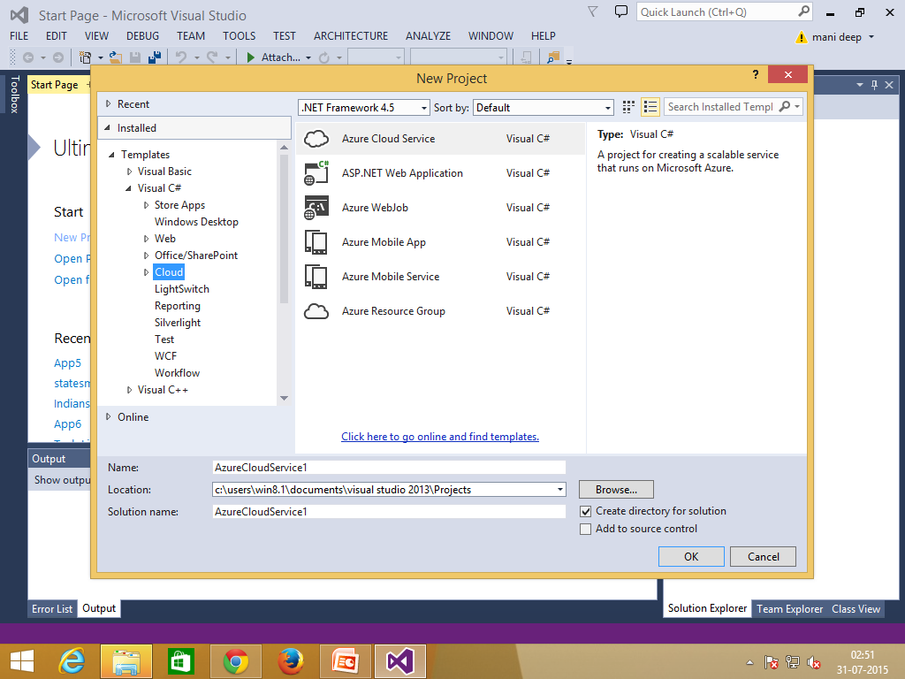
Cloud Project with a Web Role

Slide 16
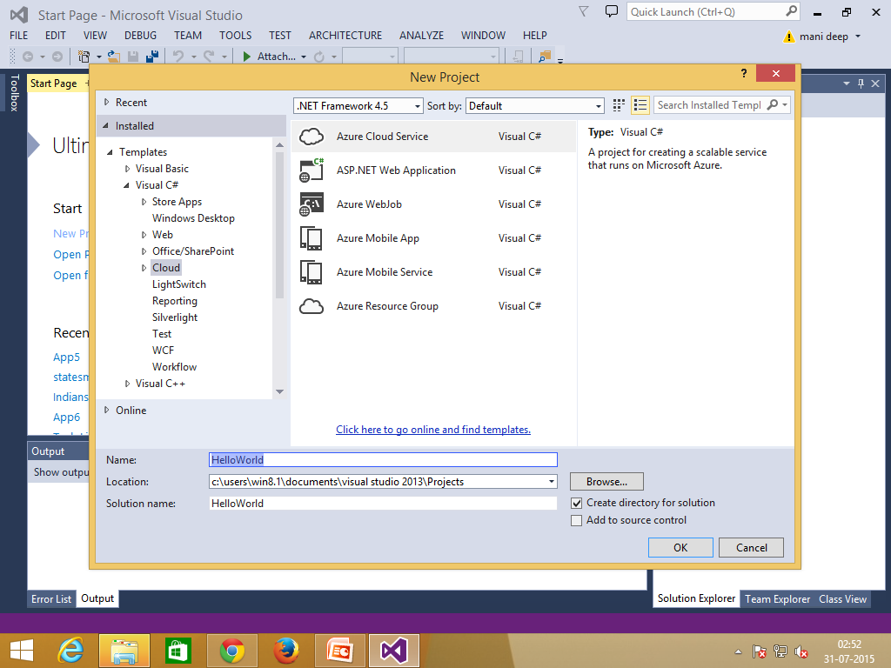
Cloud Project with a Web Role

Slide 17
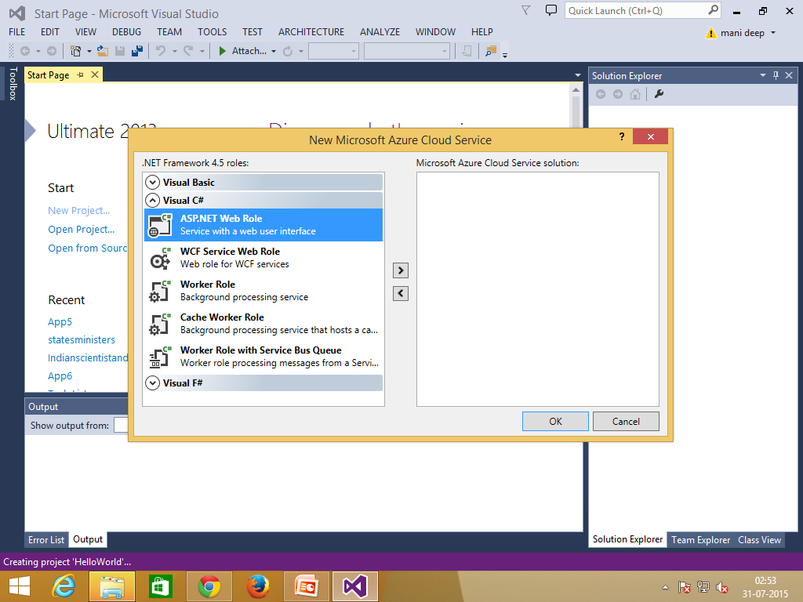
Cloud Project with a Web Role

Slide 18
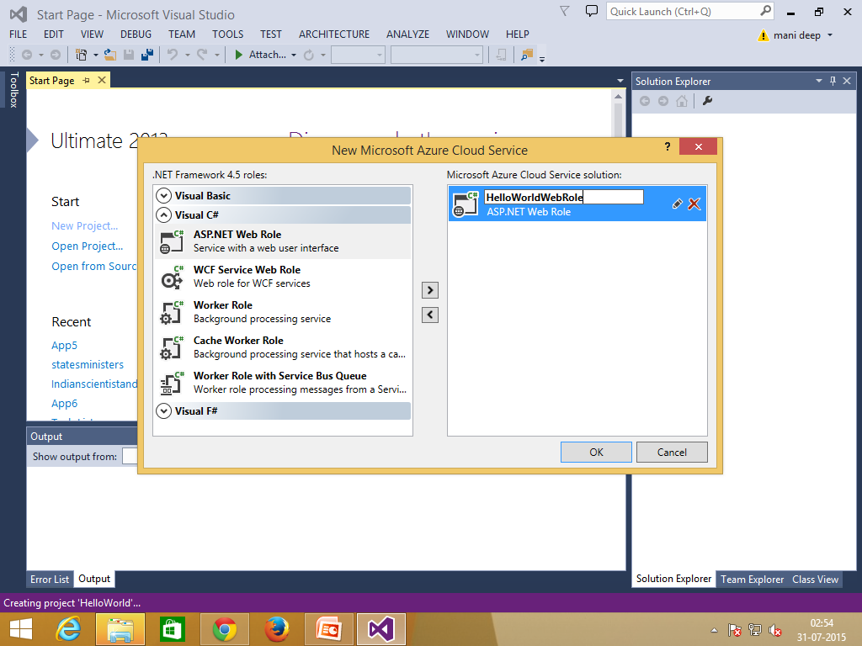
Cloud Project with a Web Role

Slide 19
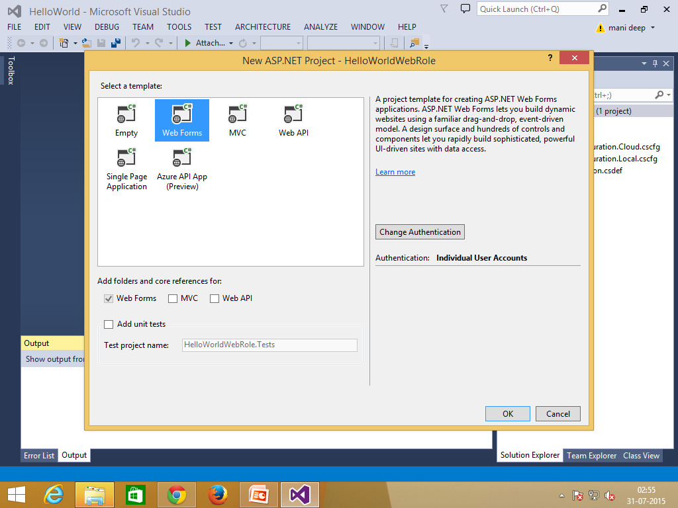
Cloud Project with a Web Role

Slide 20
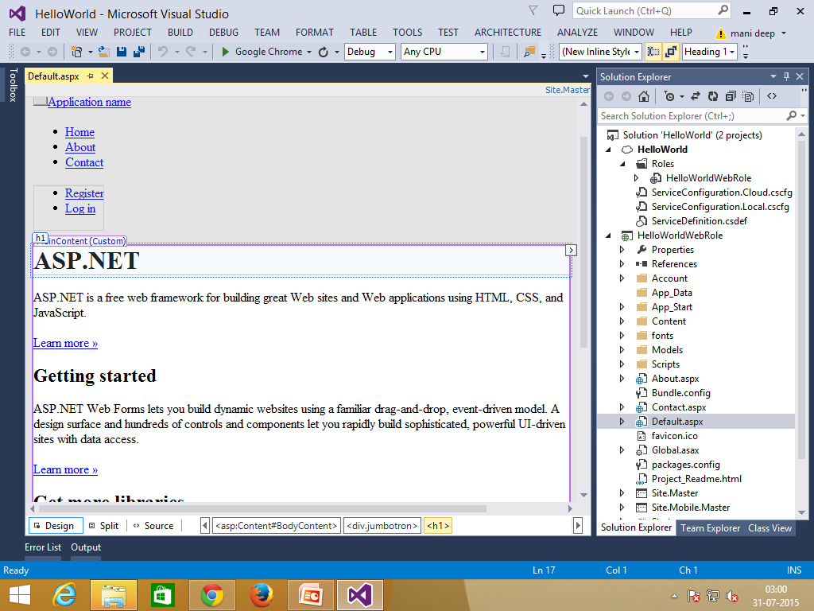
Cloud Project with a Web Role

Slide 21
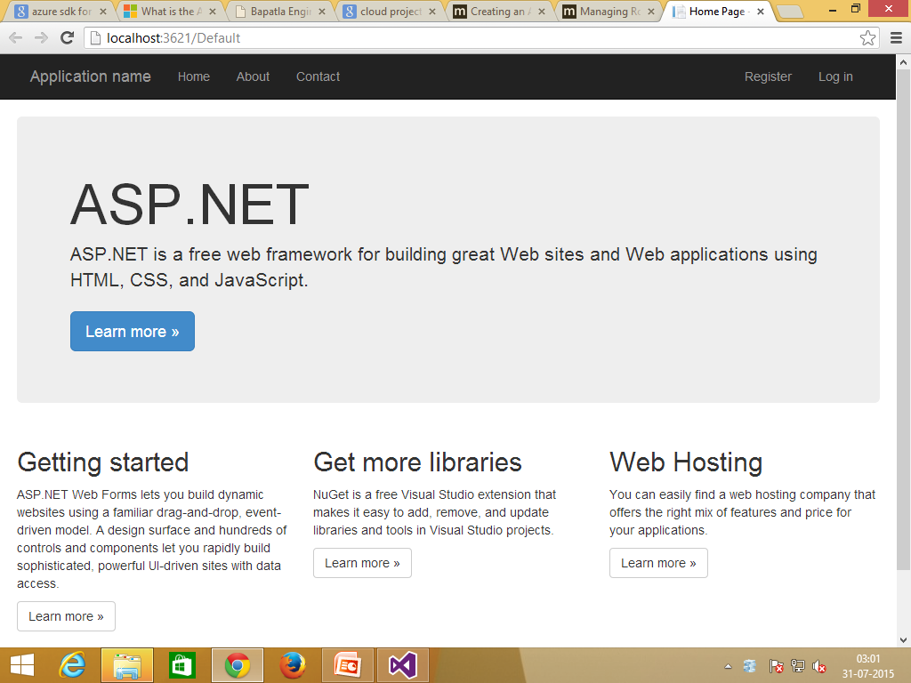
Cloud Project with a Web Role

Slide 22
Deployment to Windows Azure
One have two methods to upload cloud service to azure.
Publish using Visual studio
Manual Deploy

Slide 23
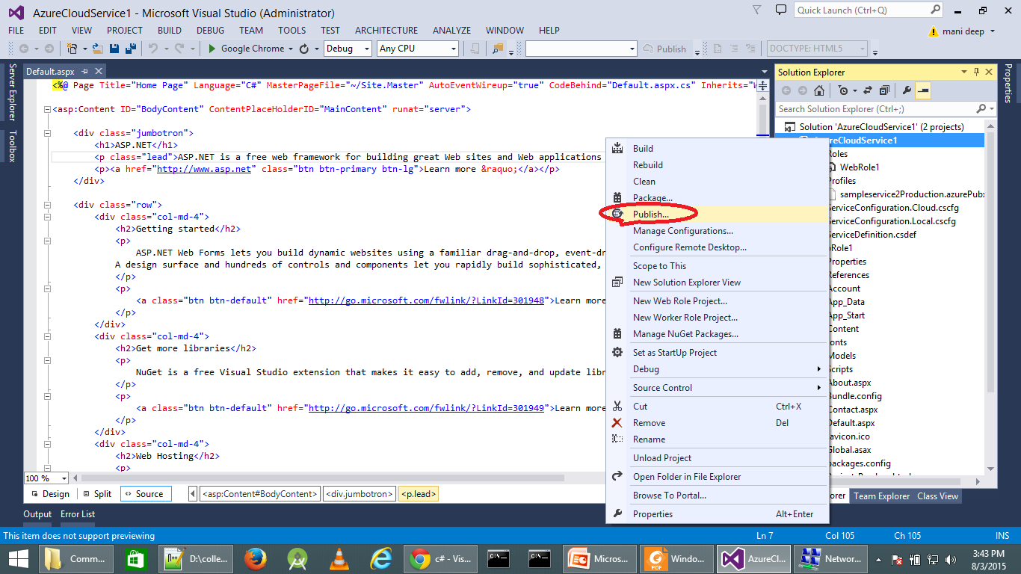
Publish using VS

Slide 24
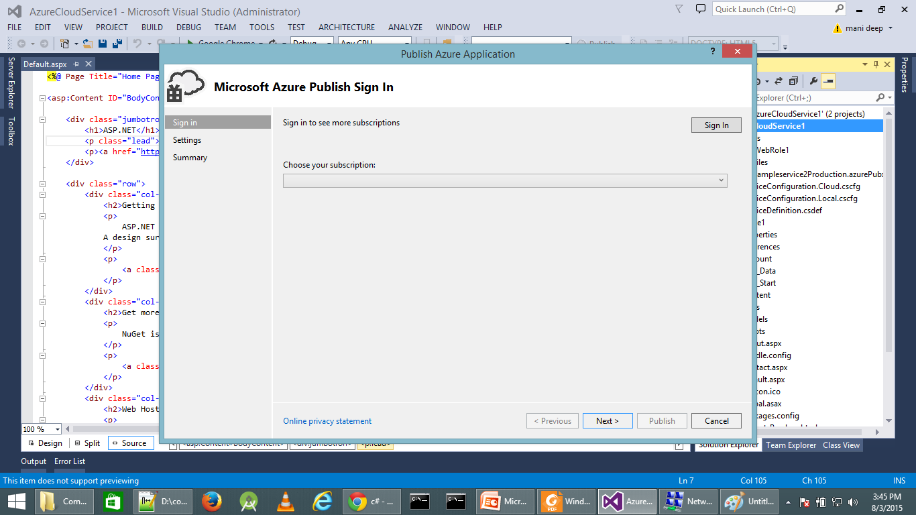
Publish using VS

Slide 25
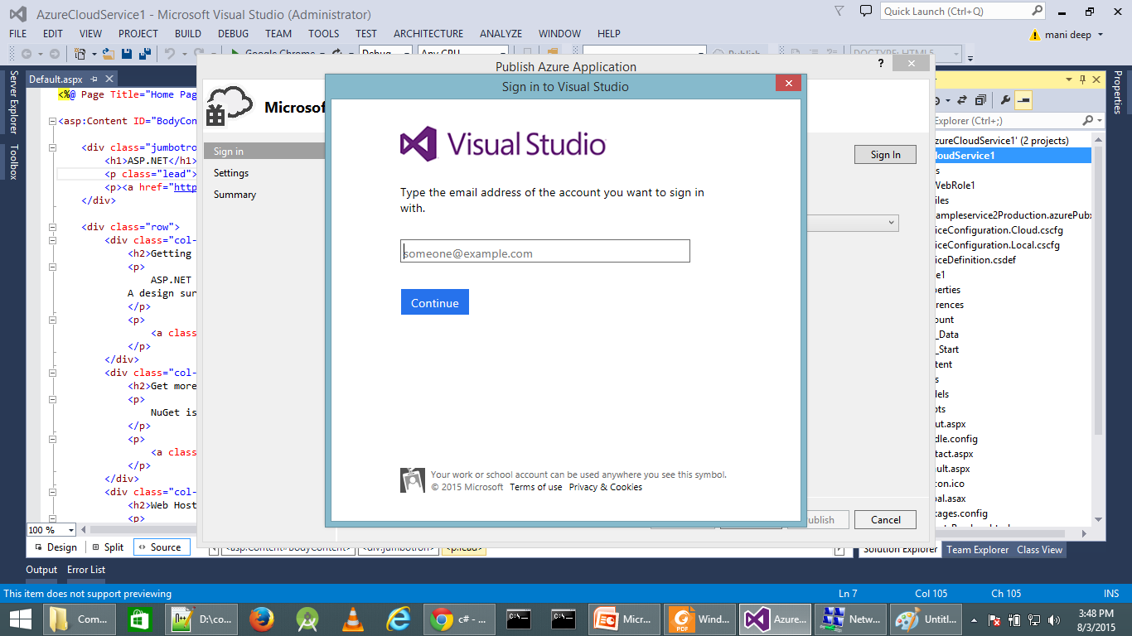
Publish using VS

Slide 26
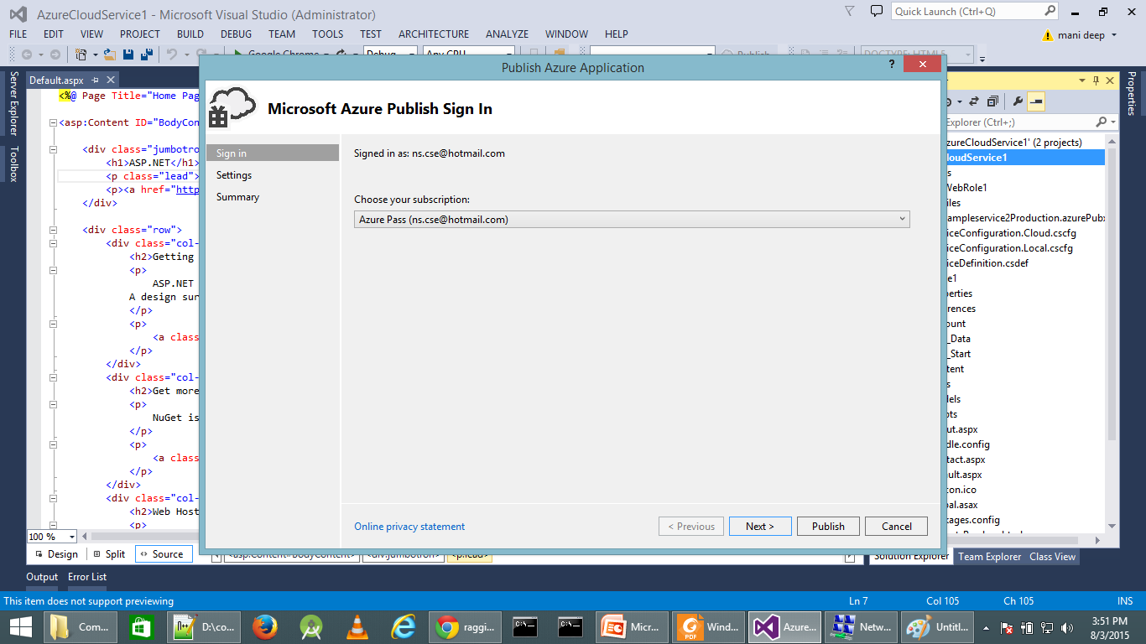
Publish using VS

Slide 27
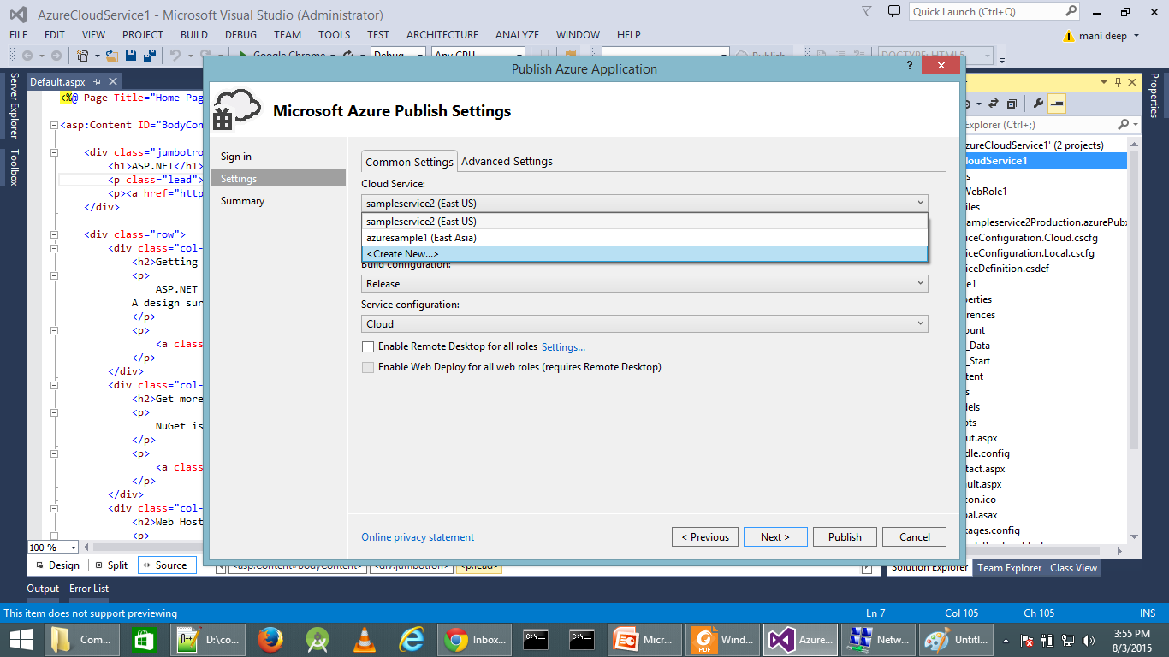
Publish using VS

Slide 28
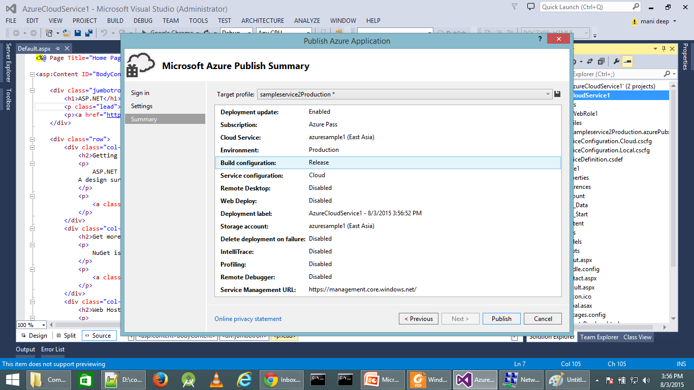
Publish using VS

Slide 29
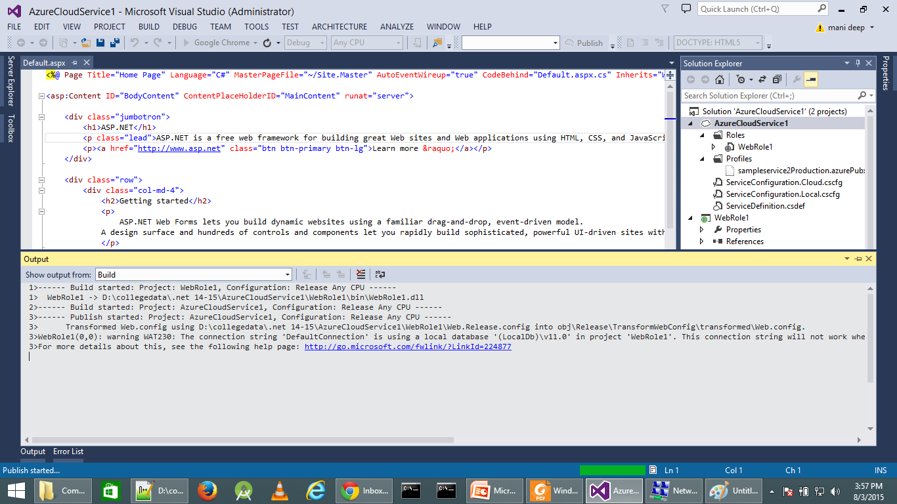
Publish using VS

Slide 30
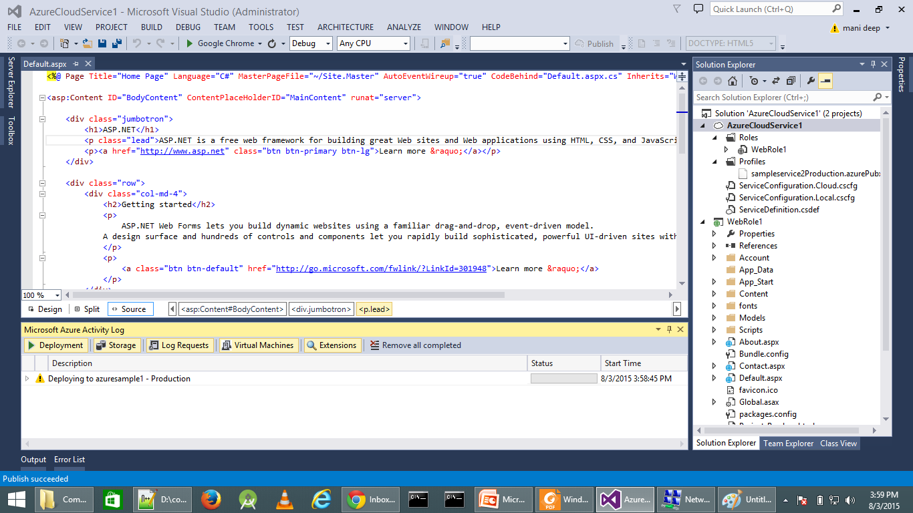
Publish using VS

Slide 31
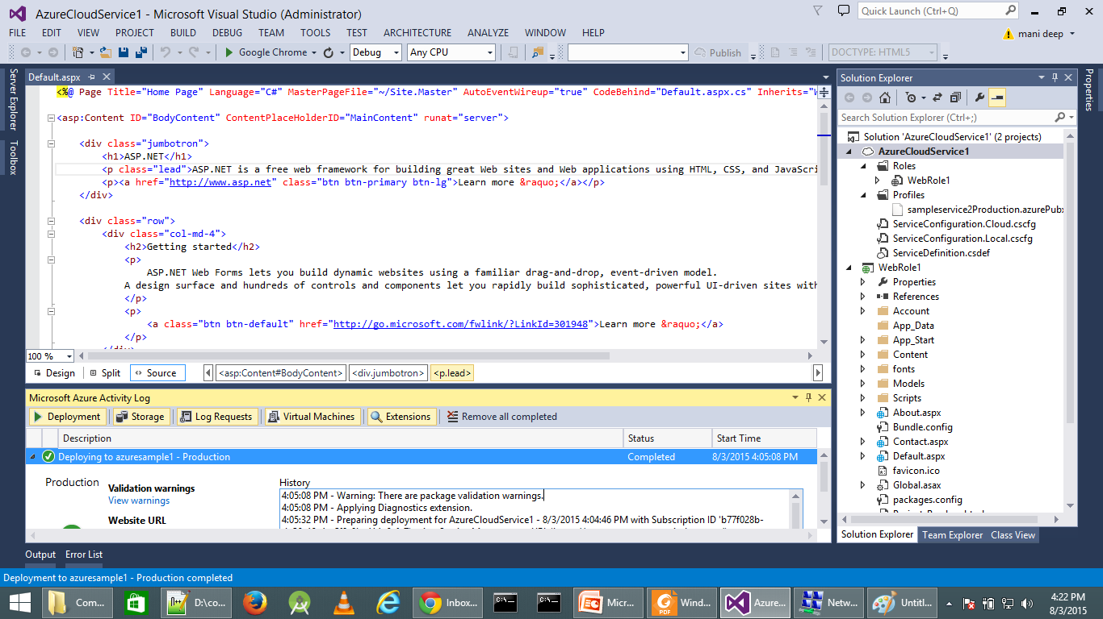
Publish using VS

Slide 32
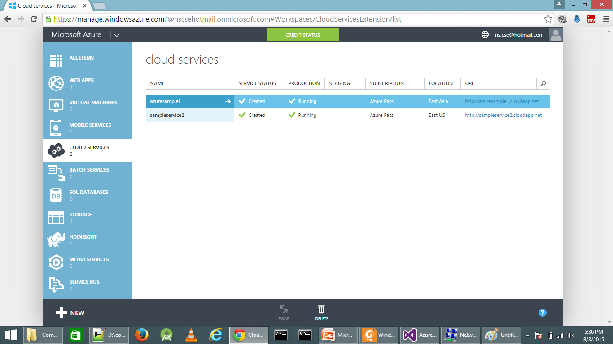
Publish using VS

Slide 33
Manual Deploy
Create a Package using Visual studio.
Login to manage.windowsazure.com
Create a new Cloud service.
Click on the arrow after cloud service name.
Choose New Production Deployment under Deployment Settings.
Give the Deployment label, package and .cscfg file.

Slide 34
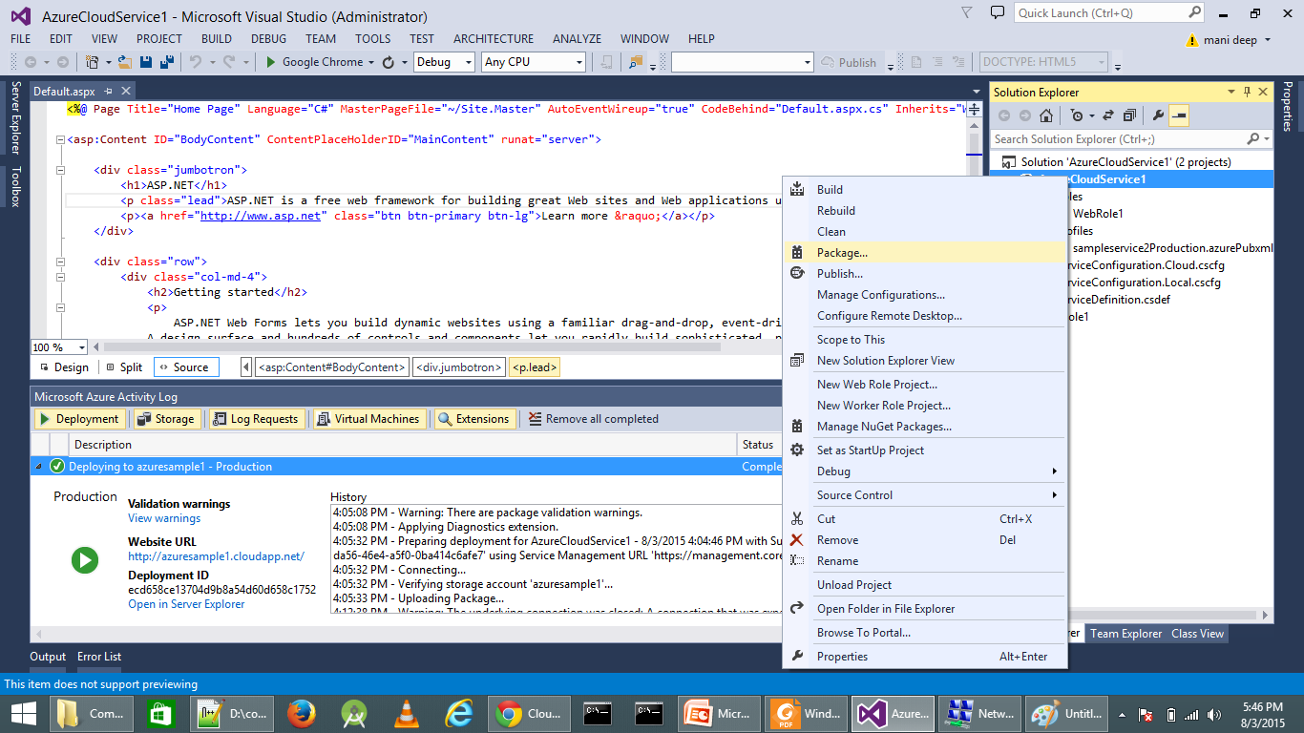
Manual Deploy

Slide 35
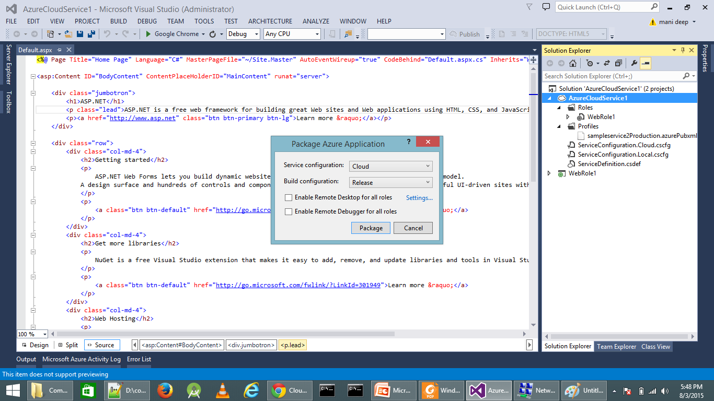
Manual Deploy

Slide 36
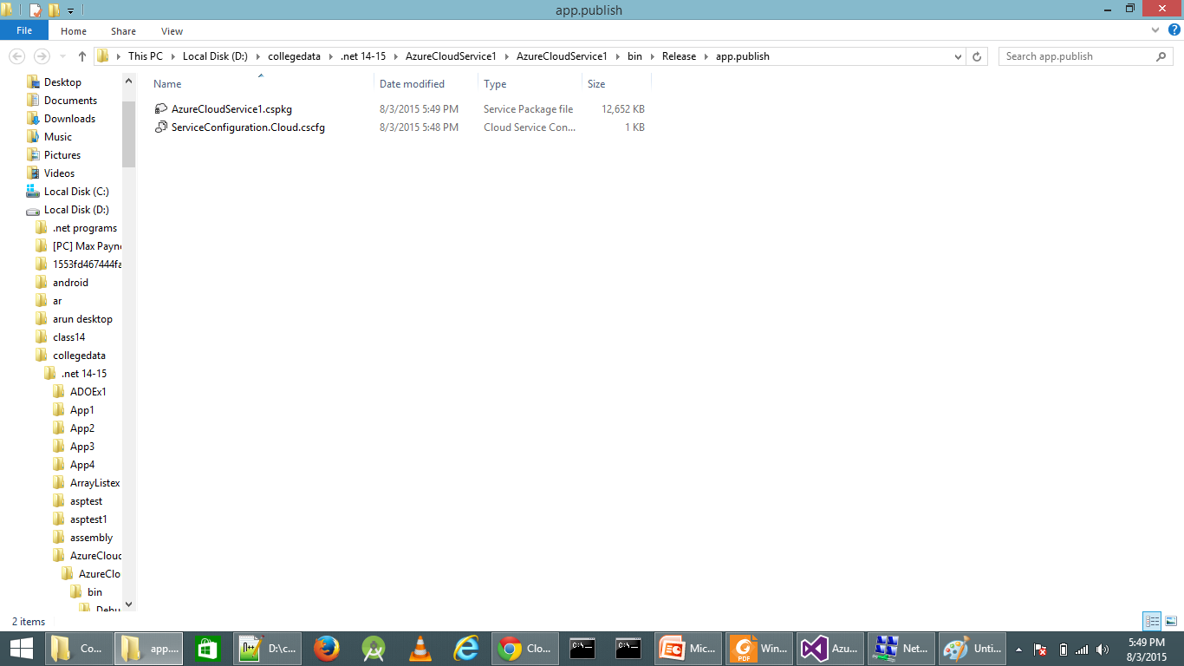
Manual Deploy

Slide 37
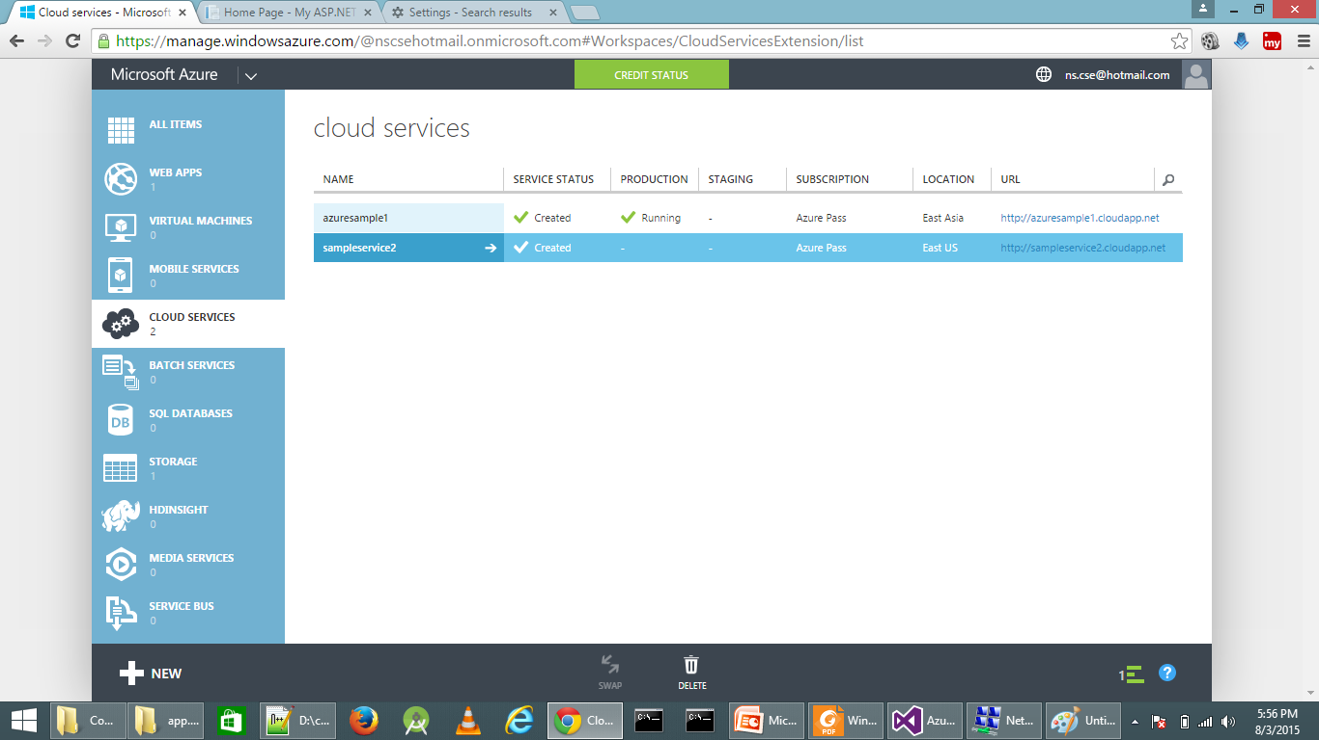
Manual Deploy

Slide 38
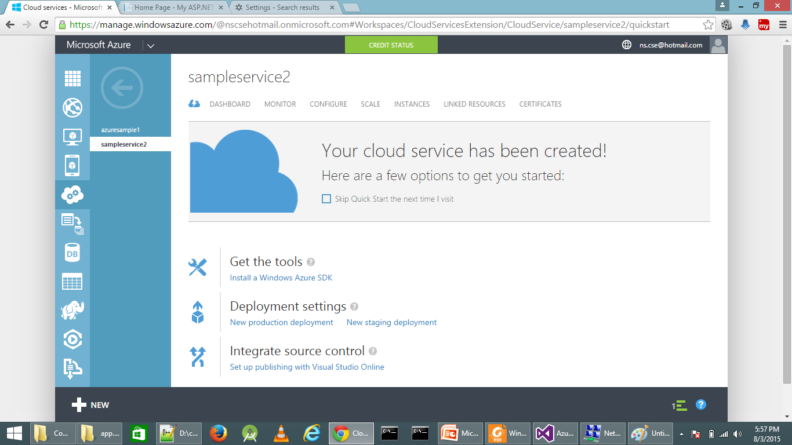
Manual Deploy

Slide 39
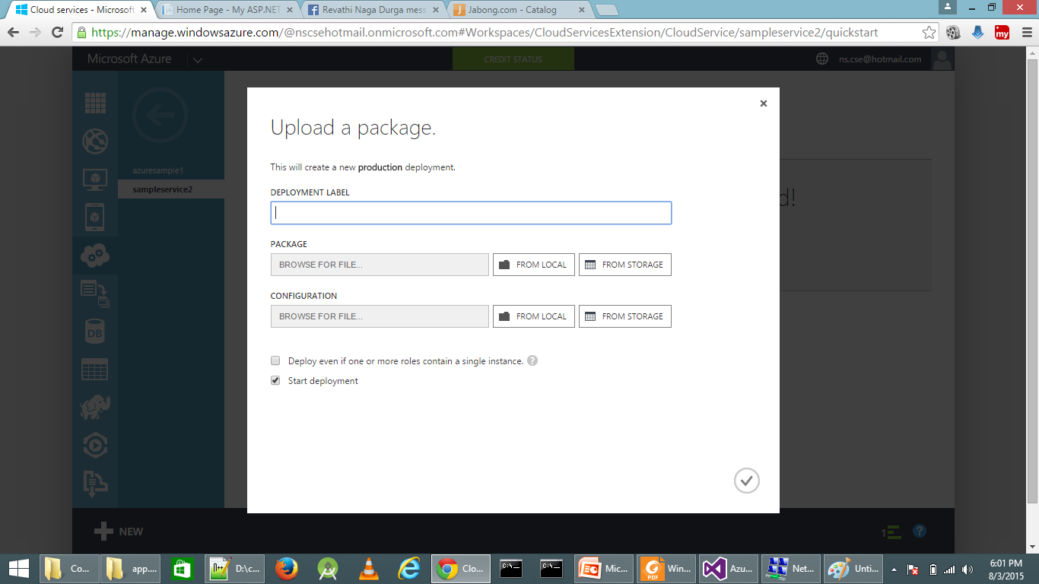
Manual Deploy

Slide 40
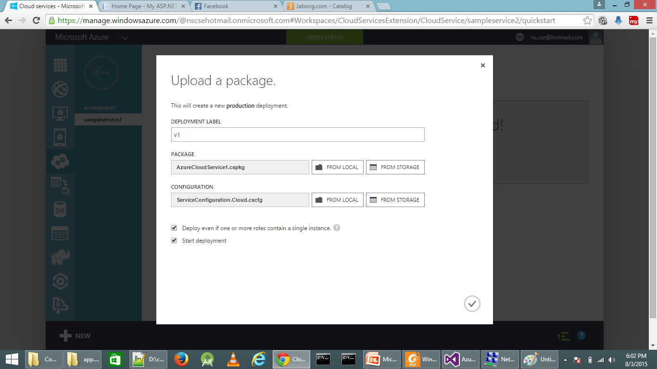
Manual Deploy

Slide 41
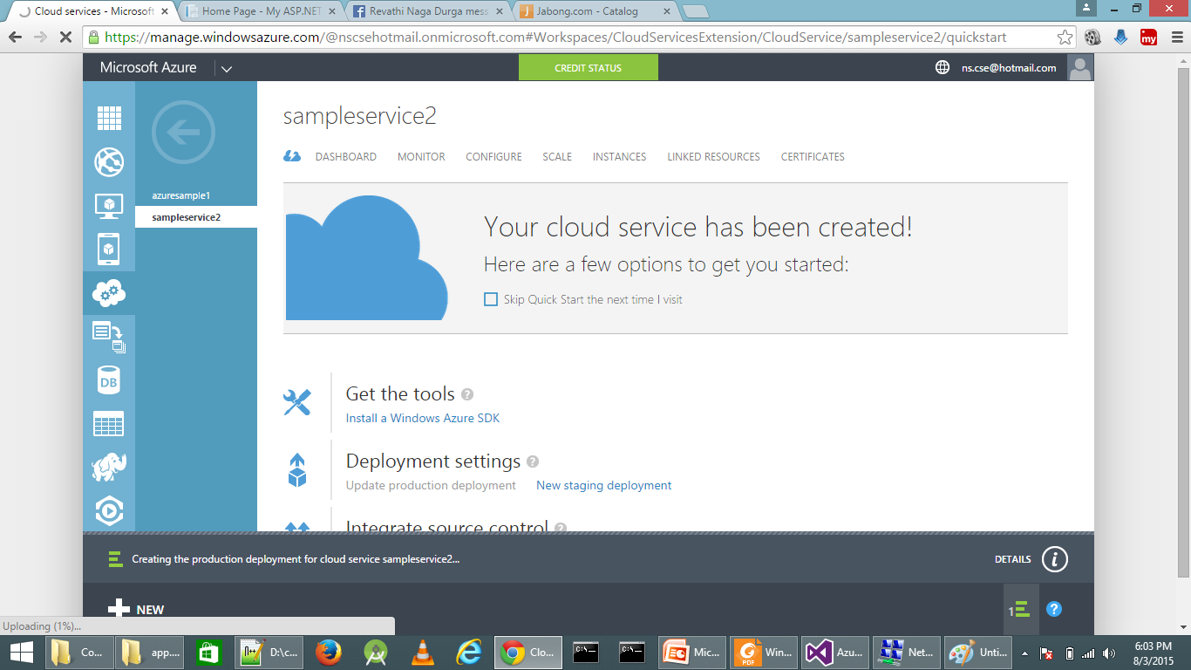
Manual Deploy

Slide 42
Configuration
Service Definition Schema(.csdef)
The service definition file defines the service model for an application.
The file contains the definitions for the roles that are available to a cloud service, specifies the service endpoints, and establishes configuration settings for the service.
Configuration setting values are set in the service configuration file, as described by the Azure Service Configuration Schema (.cscfg File).

Slide 43
Configuration
Service Configuration Schema(.cscfg)
The service configuration file specifies the number of role instances to deploy for each role in the service, the values of any configuration settings, and the thumbprints for any certificates associated with a role.
If the service is part of a Virtual Network, configuration information for the network must be provided in the service configuration file, as well as in the virtual networking configuration file.
The default extension for the service configuration file is .cscfg.

